Slide 1


EXPLORATORY DATA ANALYSIS (EDA) OF CRICKET DATA
USING PYTHON
PRAKASH KUMAR L

Slide 2





DATASET
OVERVIEW
✅ Source: Cricsheet
✅ Types of Matches: ODI, T20, IPL, Test
✅ Features Explored: Runs, Wickets, Win/Loss, Strike Rate, Economy

Slide 3
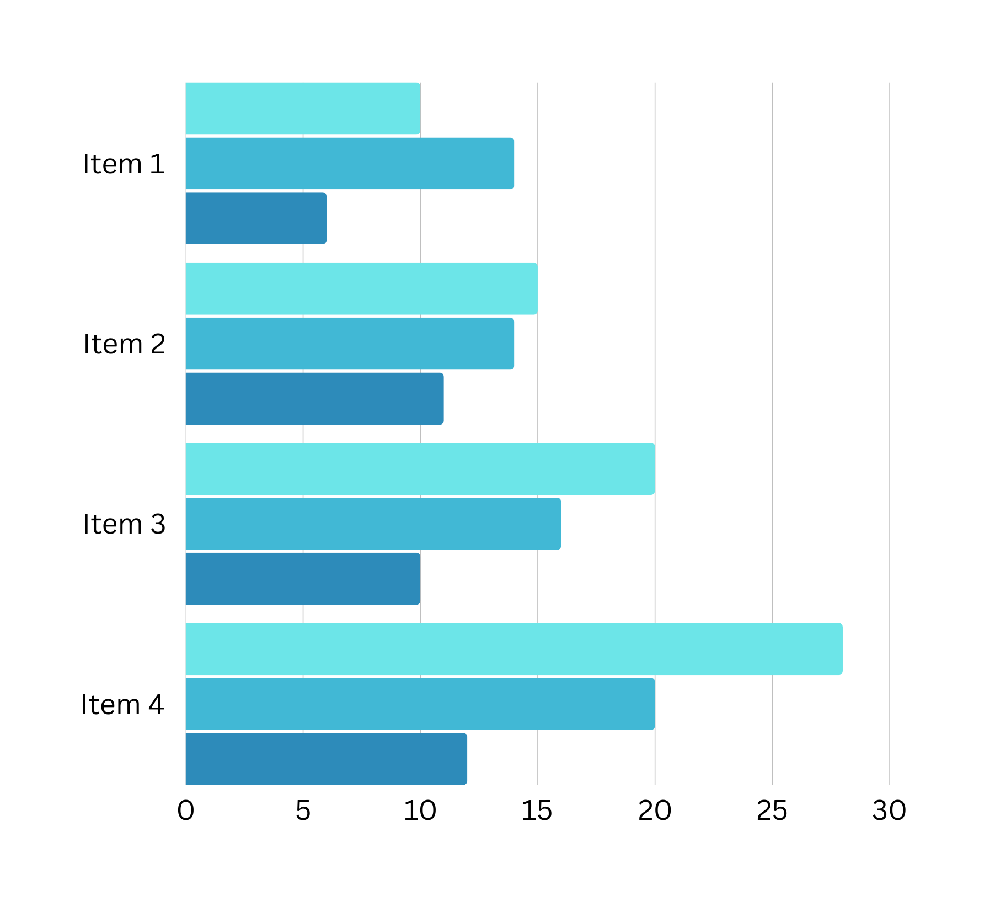
DONUT CHART
STACKED BAR CHART
PIE CHART
SCATTER CHART
DIFFERENT VIRTUALIZATION USED
HORIZONTAL BAR CHART
3D SCATTER CHART
LINE CHART
VERTICAL BAR CHART
AREA CHART
VERTICAL STACKED BAR CHART

Slide 4
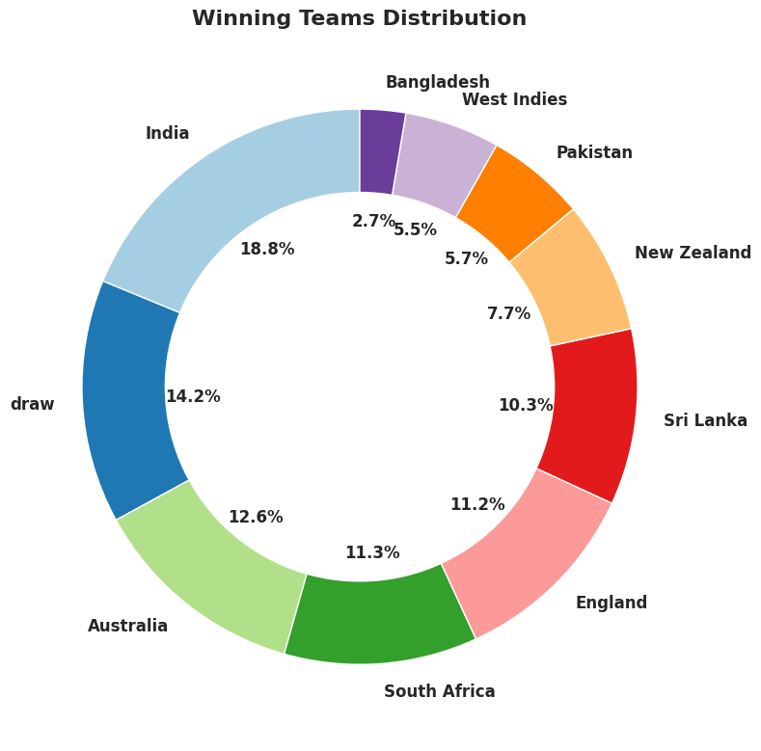

WINNING TEAMS DISTRIBUTION IN TEST
Chart Type: Donut Chart
Insights
✅ Team Dominance
✅ Competitive Balance
✅ Trends in Team Performance
✅ Underdog Performance

Slide 5
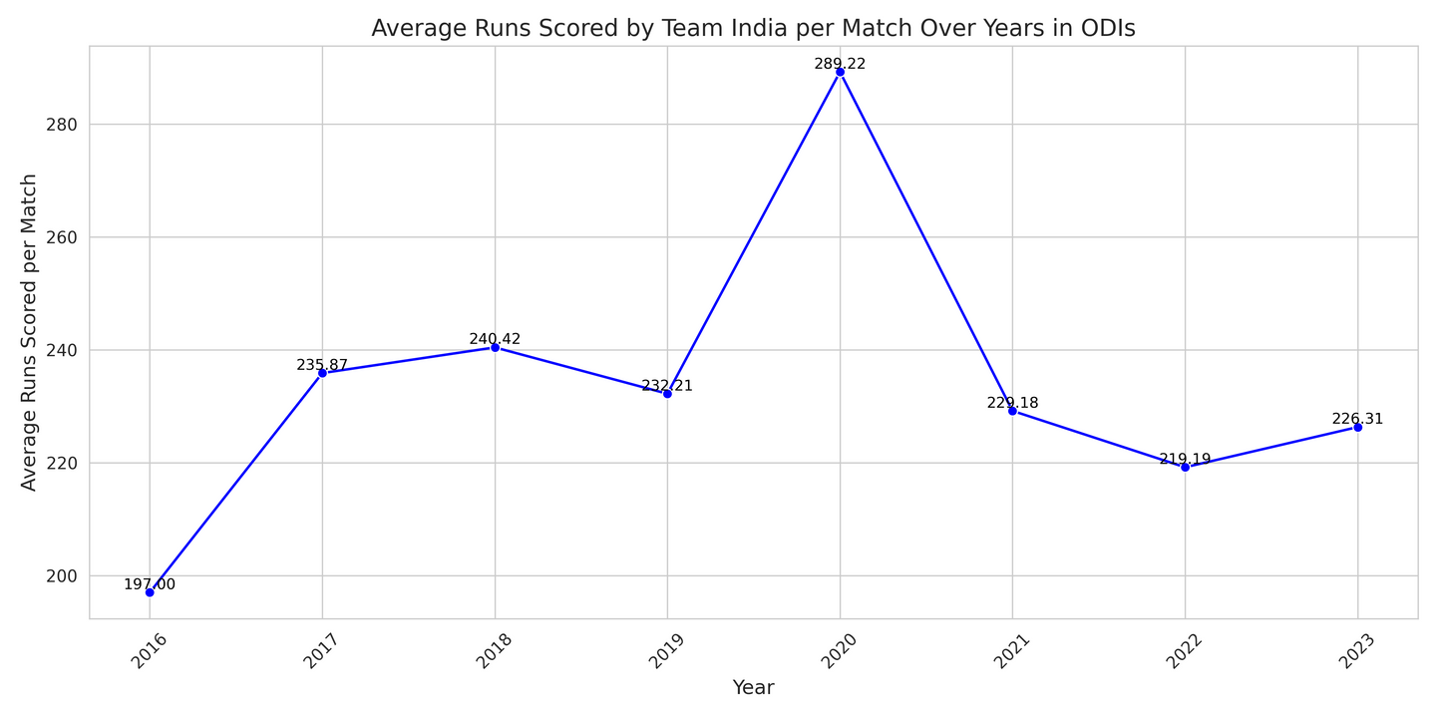
TEAM INDIA’S AVERAGE RUNS PER MATCH (YEARLY)
✅ Insight: Tracks India's batting consistency over the years.
✅ Chart Type: Line Chart

Slide 6
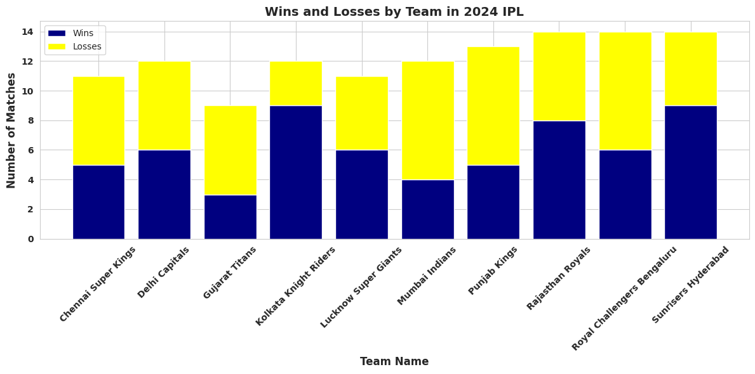

WINS & LOSSES IN IPL 2024
Insights
✅ Top Performing Teams – Teams with the most wins.
✅ Struggling Teams – Teams with more losses than wins.
✅ Inconsistent Teams – Teams with nearly equal wins and losses.
✅ Chart Type: Vertical Stacked Bar Chart

Slide 7
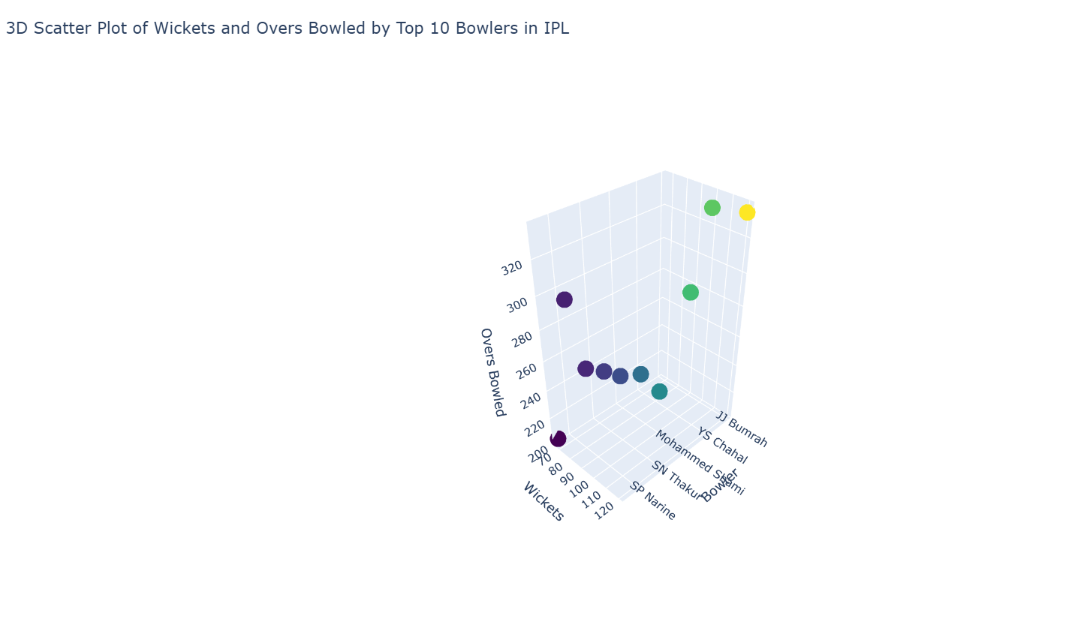
WICKETS & OVERS BOWLED BY TOP 10 BOWLERS IN IPL
✅ Chart Type: 3D Scatter Plot
✅ Insight: Shows the efficiency of bowlers in terms of wickets taken vs. overs bowled.

Slide 8
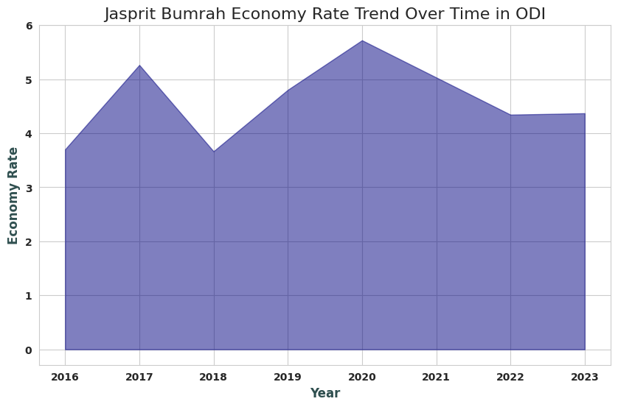
ECONOMY RATE YEAR-WISE
✅ INSIGHT: EXAMINES HOW BOWLERS' ECONOMY RATES CHANGE OVER TIME.
✅ CHART TYPE: AREA CHART

Slide 9
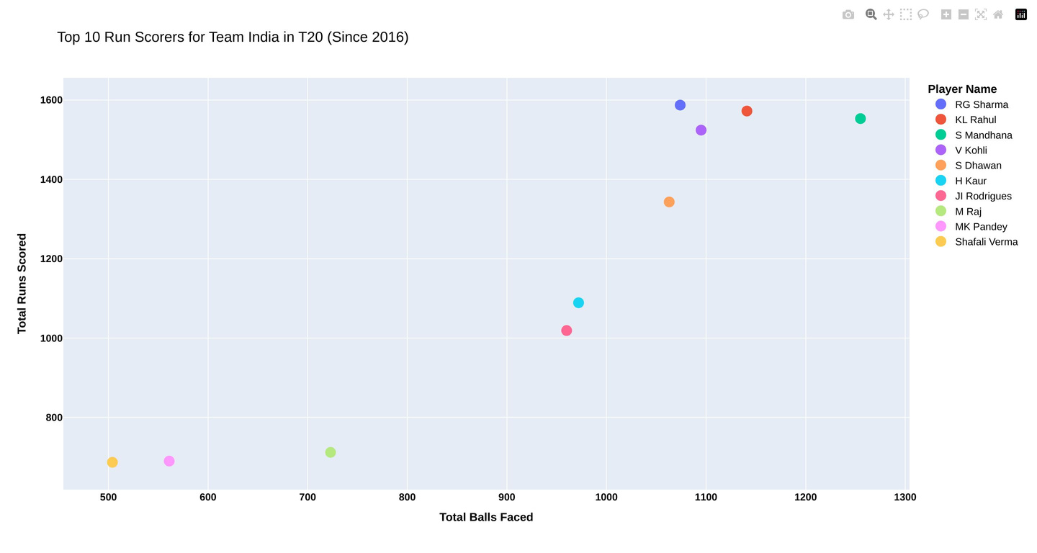
TOP 10 RUN SCORERS FOR TEAM INDIA IN T20
Insights
✅ Top Performers – Identifies India's top 10 T20 run scorers since 2016, highlighting the most impactful batters.
✅ Playing Style Variations – Some players accumulate runs steadily over many balls, while others score quickly in fewer deliveries
✅ Chart Type: Scatter Chart

Slide 10
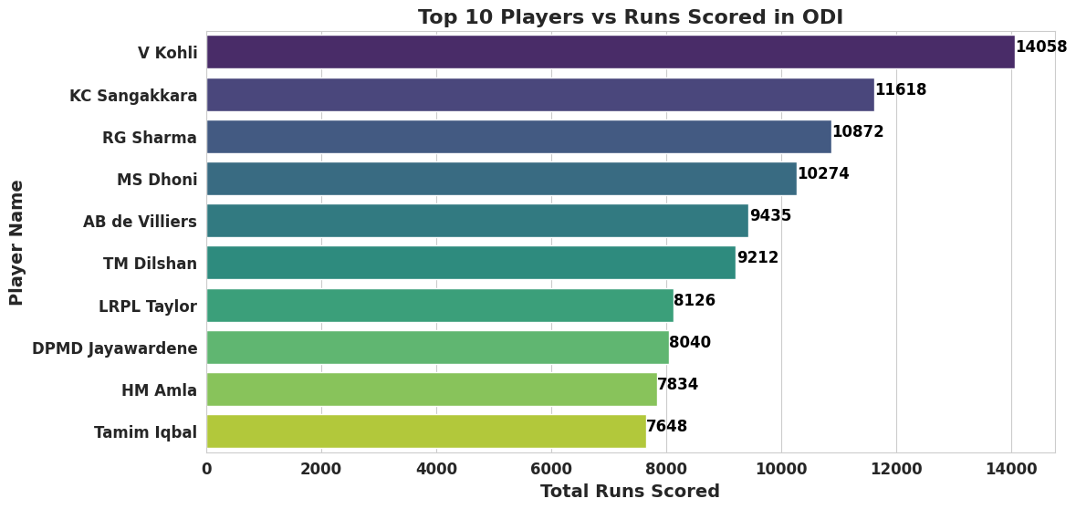
TOP 10 PLAYERS VS. RUNS SCORED IN ODI
✅ Insight: Compares top-performing ODI batsmen based on total runs.
✅ Chart Type: Horizontal Bar Chart

Slide 11

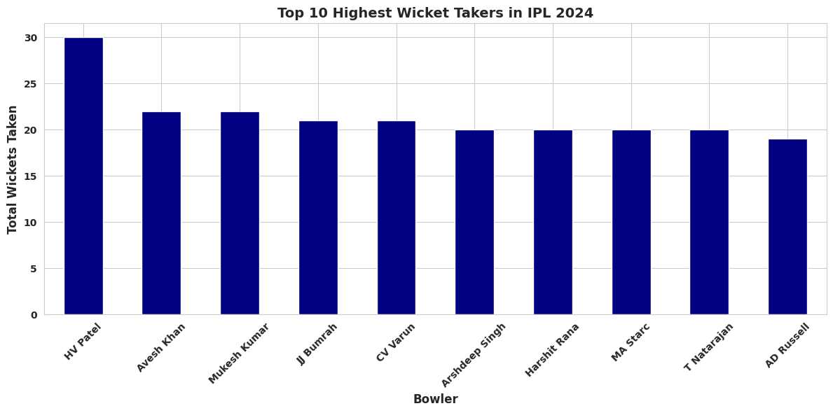
TOP 10 HIGHEST WICKET TAKERS IN IPL 2024
✅ Insight: Highlights the best bowlers in IPL 2024.
✅ Chart Type: Vertical Bar Chart

Slide 12
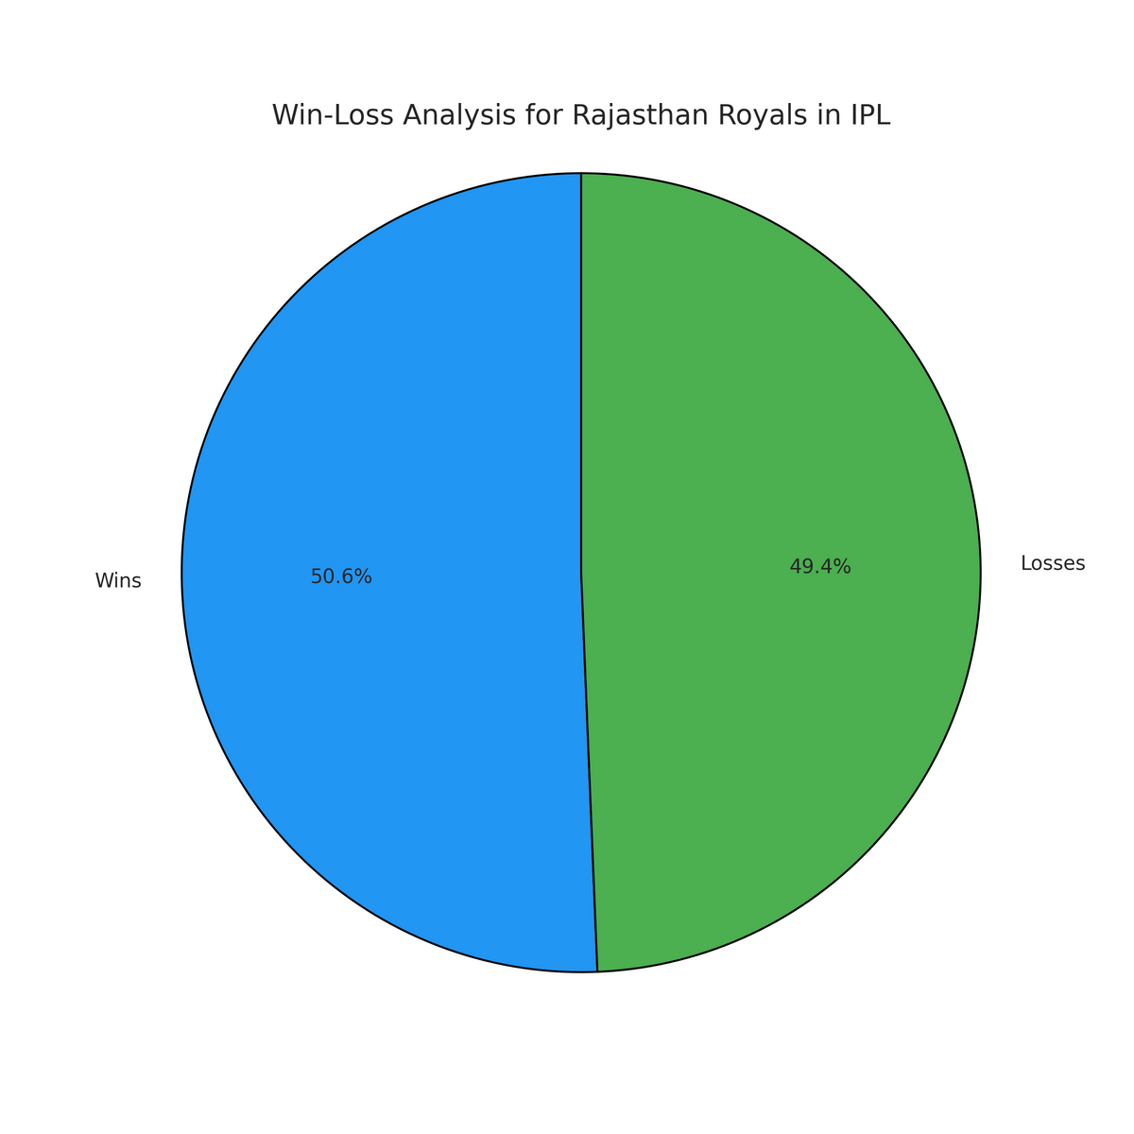
RAJASTHAN ROYALS WIN/LOSS PIE CHART
✅ Insight: Focused breakdown of Rajasthan Royals' performance.
✅ Chart Type: Pie Chart

Slide 13

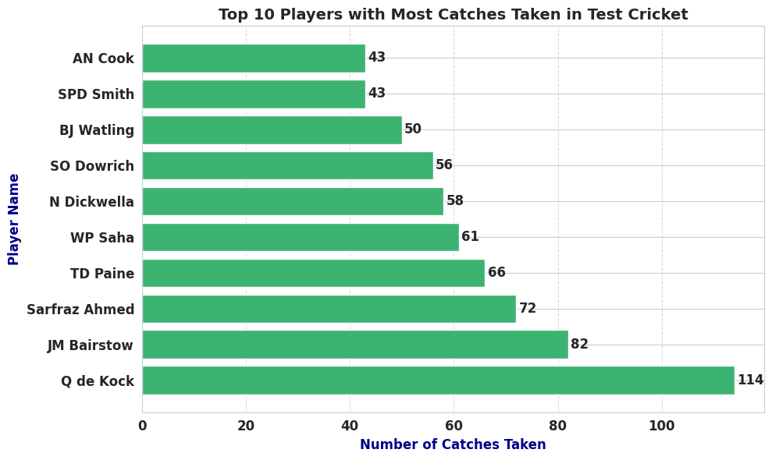
MOST NUMBER OF CATCHES TAKEN
✅ Insight: Shows fielding performance based on the number of catches taken.
✅ Chart Type: Bar Chart

Slide 14
CONCLUSION
v
✅ Visualizing cricket data using libraries like Matplotlib, Seaborn, and Plotly can reveal key insights.
✅ Team Performance: Bar charts can compare teams' win/loss records over seasons, highlighting dominant teams and competitive balance.​
✅ Player Statistics: Scatter plots can show correlations between metrics like balls faced and runs scored, identifying consistent performers.​
✅ Match Outcomes: Pie charts can display the distribution of match results, indicating trends like the effectiveness of chasing versus setting targets.​
✅ Trend Analysis: Line graphs can track players' economy rates or batting averages over time, revealing improvements or declines in performance.​
✅ Utilizing these visualizations helps in uncovering patterns and making informed decisions based on cricket data.

Slide 15

THANK YOU

